Slide 1
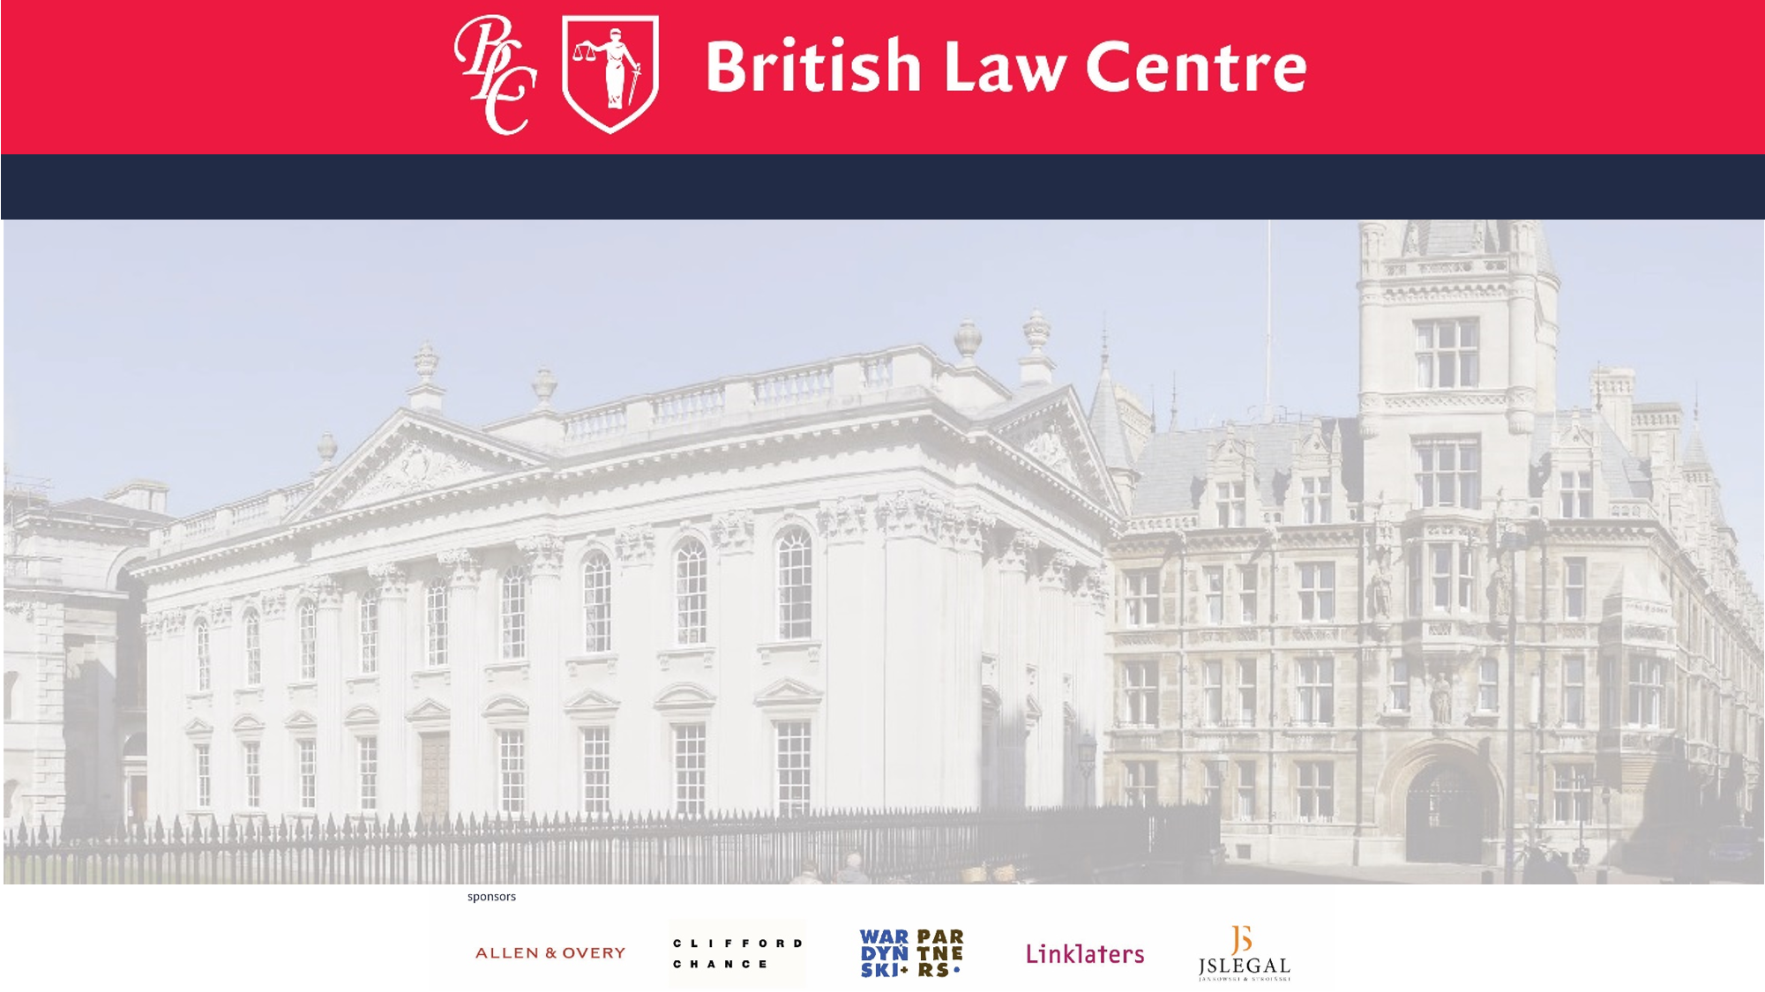
Are you fluent in English
but want to improve
your English legal language?
Do you want to find out more about the common law and how common lawyers think?
And how judges create law?
Interested in EU law and want to see the common law perspective?
Then come and study at the British Law Centre in Gdansk
An optional course with 6 facultative lecture points

Slide 2
The Diploma/Certificate in English and European has been taught in co-operation with the Gdansk University since 1996……
It is open to all Polish students and lawyers who have an interest in English and European Union law and who wish to learn the skills unique to English lawyers.
Come and study at the British Law Centre in Gdansk
An optional course with 6 facultative lecture points

Slide 3
For more information
please contact
Dr Monika Adamczak-Retecka
(BLC local Programme Director)
in room 4053 , e-mail to :
mretecka@prawo.ug.edu.pl
or
visit the UG WPIA web site
http://prawo.ug.edu.pl/strona/14669/szkola_prawa_brytyjskiego
Then come and study at the British Law Centre in Gdansk
An optional course with 6 facultative lecture points
apply to britishlawcentre.co.uk

Slide 4
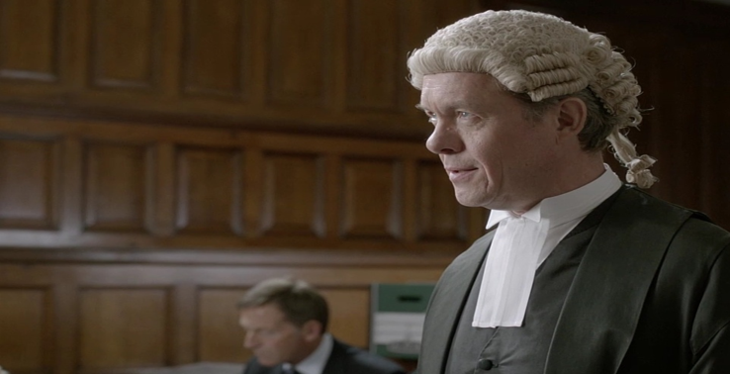
Come and find out more about us
GUEST LECTURE
Denise Ashmore
BLC Course Director
Tuesday 13th October 2015
At 13.00
In room 2026
The Common Law Methodology? Where judges are a source of law
Enrol for the British Law Centre
Diploma in 2015-16
britishlawcentre.co.uk

