Slide 1
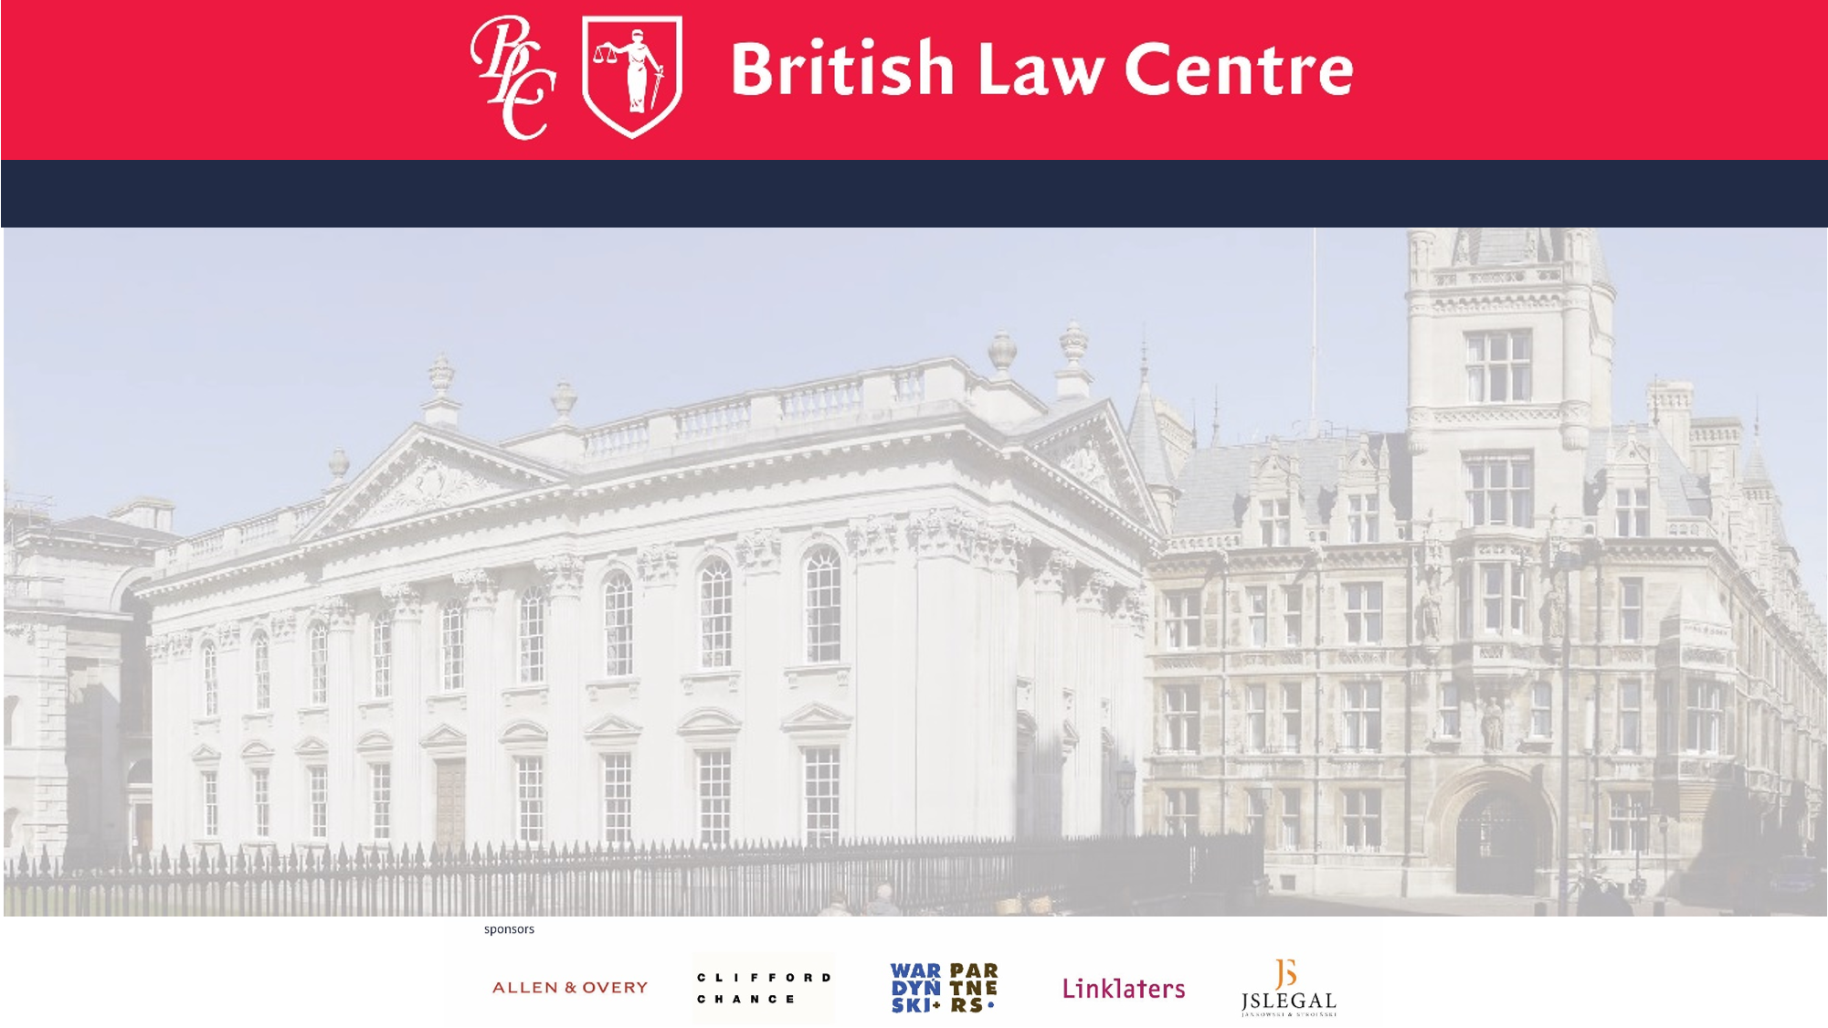

Slide 2
Are you fluent in English
but want to improve
your English legal language?
Do you want to find out more about the common law and how common lawyers think?
And how judges create law?
Do you want to improve your presentation, drafting and legal writing skills?
Interested in EU law and want to see the common law perspective?
Then come and study at the British Law Centre in Gdansk
An optional course with 6 facultative lecture points

Slide 3
The Diploma/Certificate in English and European has been taught in co-operation with the Gdansk University since 1996……
It is open to all law students and lawyers who have an interest in English and European Union law and who wish to learn the skills unique to English lawyers.
Come and study at the British Law Centre in Gdansk
An optional course with 6 facultative lecture points

Slide 4
‘The profession of a lawyer is no longer restricted to one jurisdiction only.
Complicated cases - that shape structures of contemporary business and public governance – involve not only EU law, but also analysis of a comparative nature.
A good lawyer, with an ambition to understand the role of law in a society, should always aim at developing comparative knowledge as well as linguistic skills. Relying on my own experience, I am deeply convinced that the Diploma in English and EU Law offers an excellent opportunity for a young lawyer.’
Maciej Szpunar (Advocate General to Court of Justice to European Union)
Come and study at the British Law Centre in Gdansk
An optional course with 6 facultative lecture points

Slide 5
For more information
please contact
Dr Olga Śniadach
(BLC local Programme Director)
in room 4053 , e-mail to :
cpeoh@prawo.univ.gda.pl
or
visit the UG WPIA web site
http://prawo.ug.edu.pl/strona/14669/szkola_prawa_brytyjskiego
Then come and study at the British Law Centre in Gdansk
An optional course with 6 facultative lecture points
apply to britishlawcentre.co.uk

